Slide 1



Slide 2


Concept
Imagine a universe where Star Wars and Dungeons & Dragon fans merge role playing games with calculated combat scoring….in a user friendly app to quickly add & calculate damage level of combat during a campaign
Notes:
The basic concept of this simulator is reference to Dungeons and Dragons, (Commonly known as DnD) a very popular role-playing game, allowing the player to create their own character as they embark upon imaginary adventures within a fantasy setting. Since this simulator is virtual and has DnD elements, the principle key features to this game is allowing the player to understand the complexity of rolling for point damage against opponents.

Slide 3
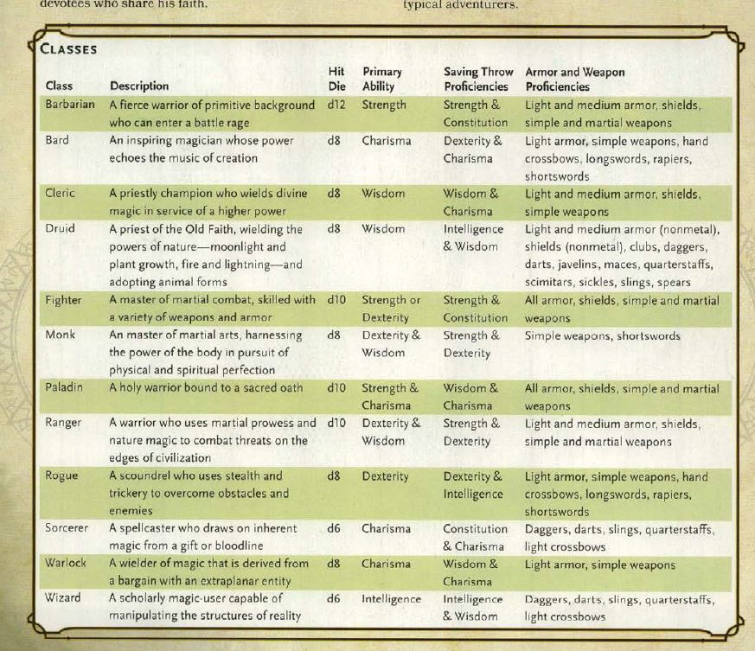
What Is All This?
Notes:
DND is a complex, strategy based game with various methods of earning & losing points, based on character strengths, skills and many other factors. In this is slide, a class sheet lists the abilities and how some of the scoring is applied with die roll

Slide 4
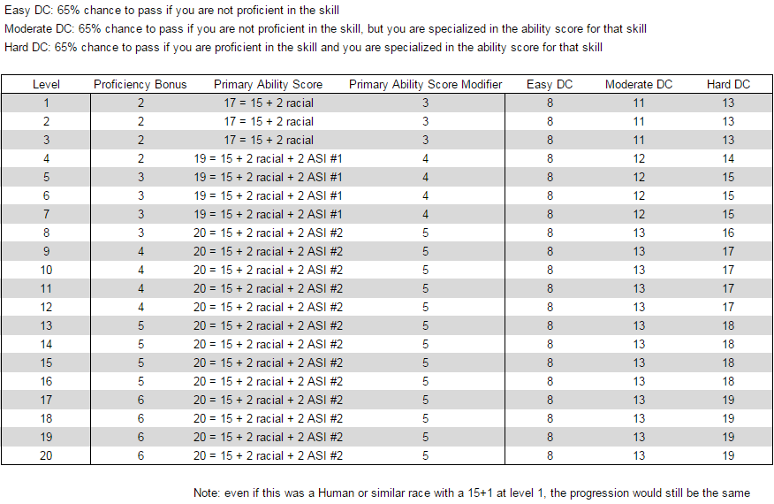
What Is All This?
Notes:
This score chart helps break down how to apply scores in combination with the class sheet in previous slide, and these abilities – which is still very complicated to calculate manually

Slide 5
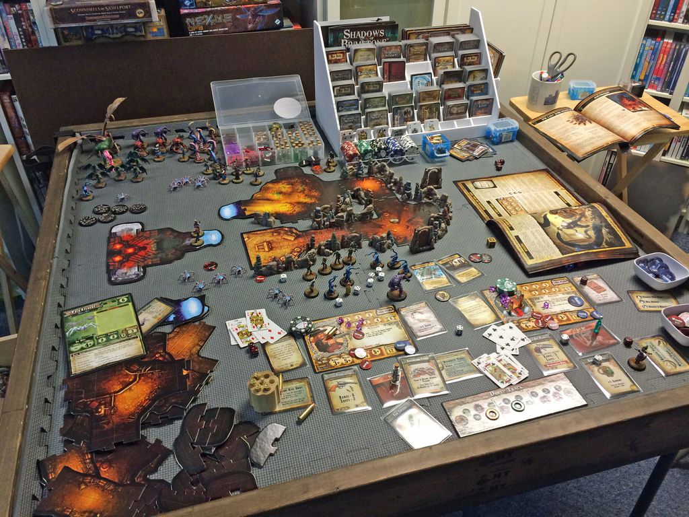
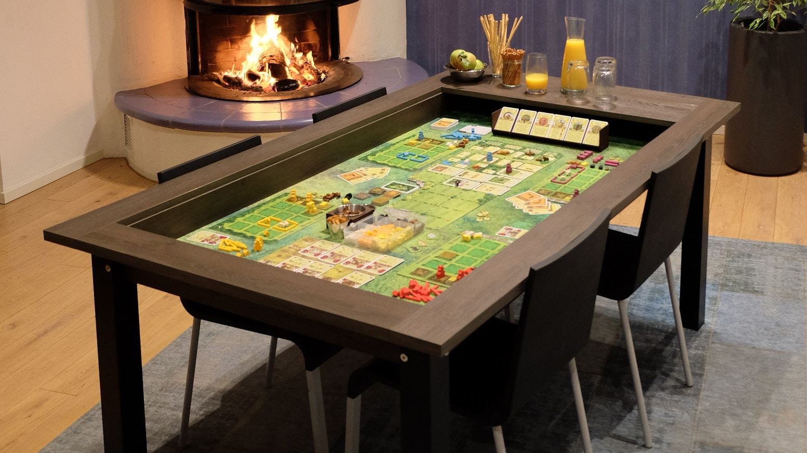
Why Do This?
DND is a fun, but complicated game, that have full participant commitment
Notes:
We simplify the time wasted on calculations, so the participants can truly enjoy the art of game play. Games can last hours with campaigns continuing for days, months or even years!

Slide 6
FEATURES
• Login or Registration Page
• Admin/DM dashboard to load scores & create campaigns
• Player dashboard to view player damage points, current & past campaigns

Slide 7
Programming Languages
Graphical User Interface – PHP/HTML/CSS
Database – MySQL
Game Play – C++
Domain – Remote Server, Mobile Responsive to most devices

Slide 8


DATABASE STRUCTURE
Users
Profile – Player abilities
Campaigns – game set up
Campaign Play – individual results
Potential Add-Ons
Avatars for each type of player
Game play selection to incorporate scoring for other RP games

Slide 9
GUI LAYOUT
Each page has a footer nav bar to link to other pages
Auto-play theme music on select pages
Statistical and profile data is displayed in formatted tables
Notes:
Theme music is set to auto play, with the option to stop on main page, login & on log out. Tables have a hover feature to highlight selected text

Slide 10
Application Roles
The site has 3 roles:
Site admin (project team members)
Dungeon Master (DM) – campaign admin can view campaign player’s profiles & abilities, add campaigns, add players, & add damage points to player, options to publish
Regular Players

Slide 11
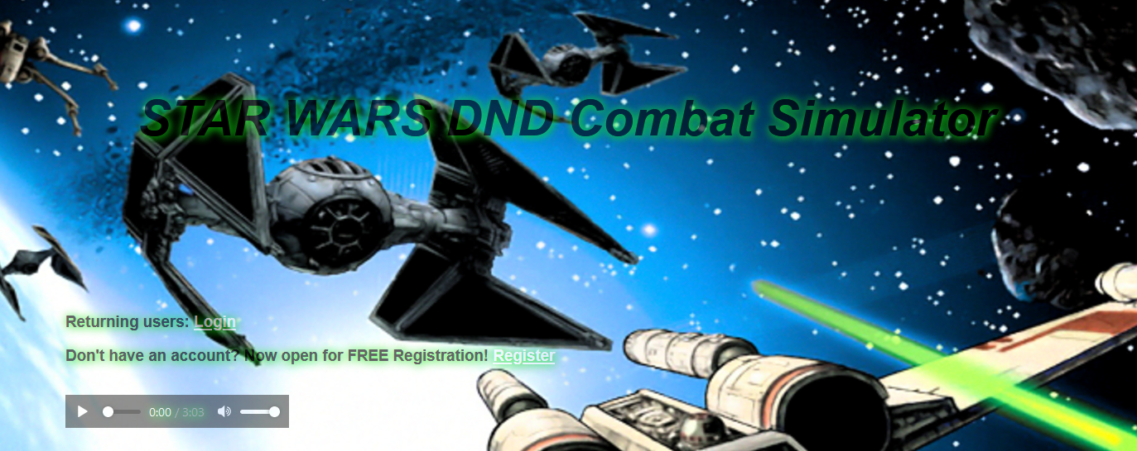
Home Page
Notes:
Similar to this presentation, we enter the site with the view of a TIE fighter engaged in battle with an X-wing. While the audio is set to auto play, users can simply press stop to end the theme music

Slide 12
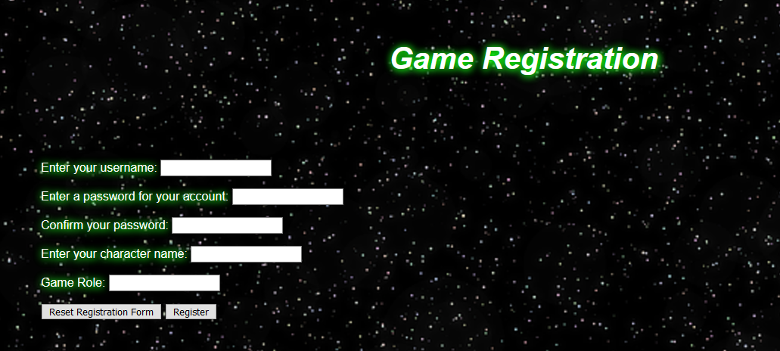
Register
Notes:
Registration requires only a few questions to establish login username, character names (for those that change their player identities) & their role as player, DM or admin

Slide 13
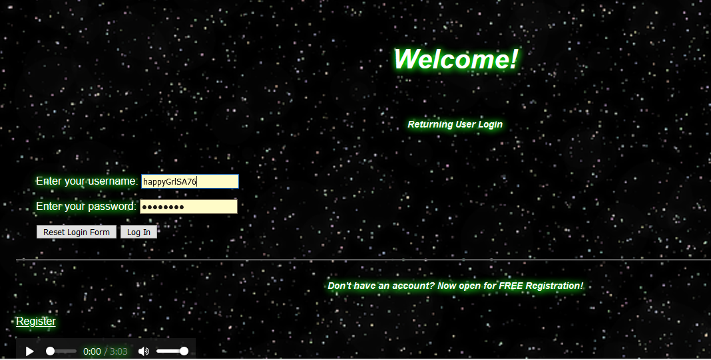
Login Screen
Notes:
Returning users are redirected to a separate login screen that also has a link to register

Slide 14
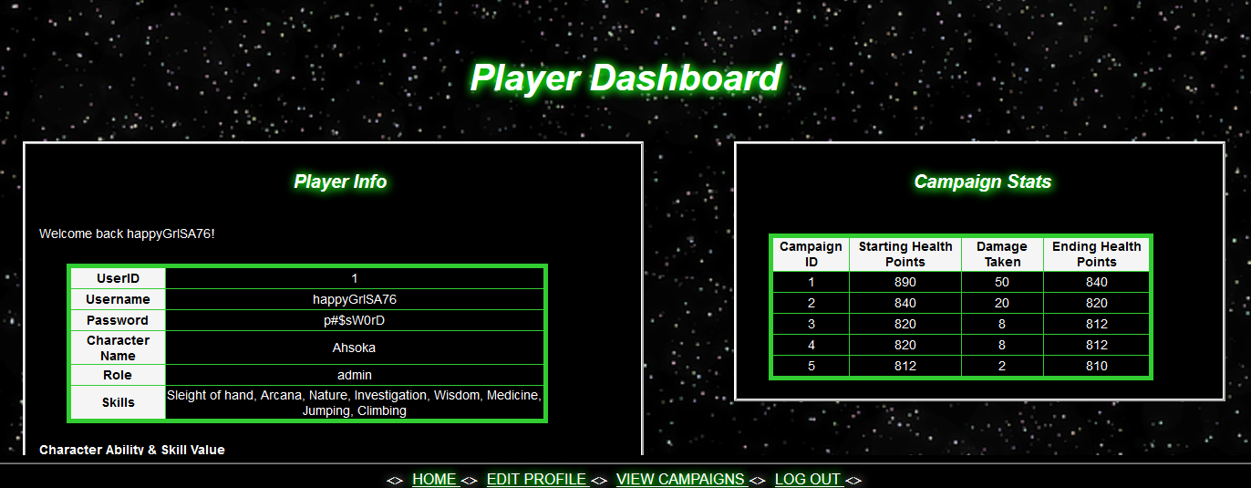
Player Membership Dashboard
Notes:
Player dashboard contains their basic user profile information, in addition to their character’s profile, and an overview of the campaign performance with the starting health points, damage taken, and remaining health at the end of the campaign. In the live version you will have a better view of information displayed and available

Slide 15
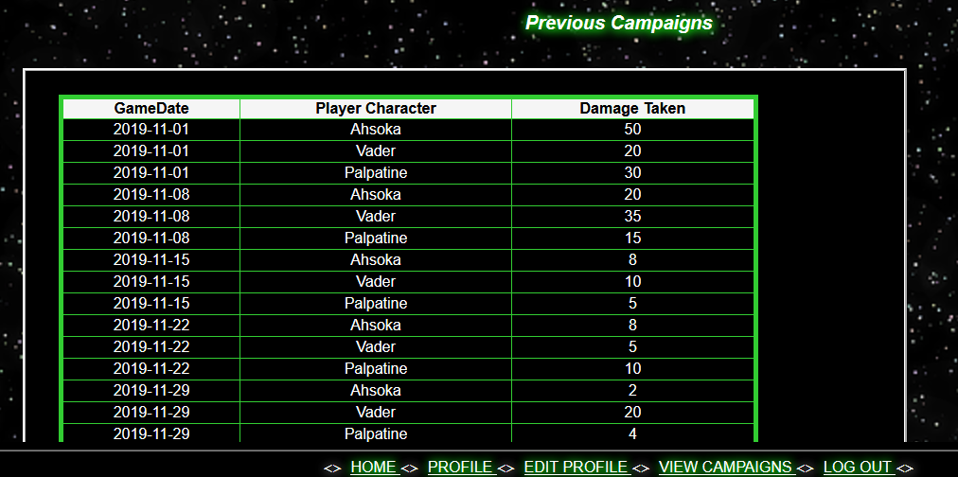
Campaign History
Notes:
Each player can view total damage taken by game date and character name (we will demonstrate with live demo of the site)

Slide 16
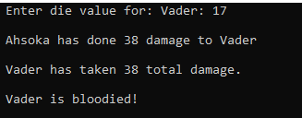
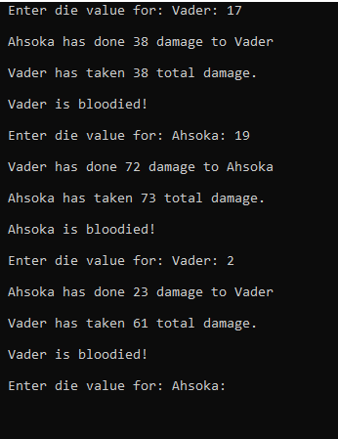
Entering Point Damage
Player 2
Notes:
To begin the simple gameplay process, the box is what the player will input die value for a character (Example: "Vader”); inputting the value (which represents rolling a die in actual DnD gaming.) the program calculates the point damage based on the character’s ability & qualitative score; In return, the player will enter the value input to the other character (“Ahsoka”) the amount of damage inflicted on “Ahsoka”.

Slide 17
Game Play – Continued Play
Notes:
In continuation of the previous slide, the example on this slide shows the input of the die value & overall damage inflicted on “Ahsoka”, which the result states that “Vader has done 38 damage to Ahsoka.” The process then repeats itself on the amount of value inputs that continue to calculate the amount of damage on both “Vader” and “Ahsoka”.

Slide 18
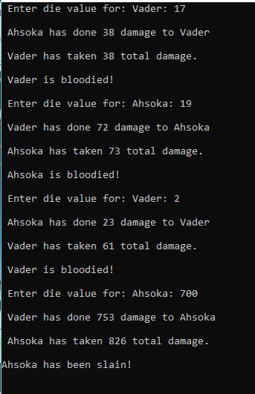
Game Play – Damage!
Notes:
In this slide, shows the total damage to the opposing player, the value input for “Ahsoka” states “19”, which calculates 72 total damage (the range is 50 point or higher), the outcome of this result states “Ahsoka is bloodied!” meaning that “Ahsoka” has taken a critical hit from their opponent.

Slide 19
Game Play – We Have a Loser!
Notes:
For the sake of brevity, we’ve entered a die value high enough to diminish the character’s remaining health balance, displaying “Ahsoka has been slain!” meaning that the character has been defeated due to the overextension of the input of the value points that is beyond 50 to 100 range, resulting with “Ahsoka” taking a final blow of 826 total damage.

Slide 20
Upcoming/Potential Features
Integrate game simulator with GUI
Game play of multiple campaigns
Profile avatars
Include opponent name in campaign history
Include calculations for contests & other activities affecting health balance

Slide 21
QUESTIONS ?

